Slide 1
Derbyshire Dales Council for Voluntary Service
Thank you to everyone who applied and helped deliver this work in their communities.
Thank you to the decision-making panel, including Grant Forrest, Rona Rawson and Claire Reece.
Thank you to Derbyshire Dales District Council for giving us the opportunity to make this happen. Particular thanks go to Amanda Brown and Gill Chapman, for making this possible.
Thanks also to the DDCVS team.
£184,450 total distributed to community projects across the Derbyshire Dales.
Notes:
Recommended display time: 26 seconds.

Slide 2

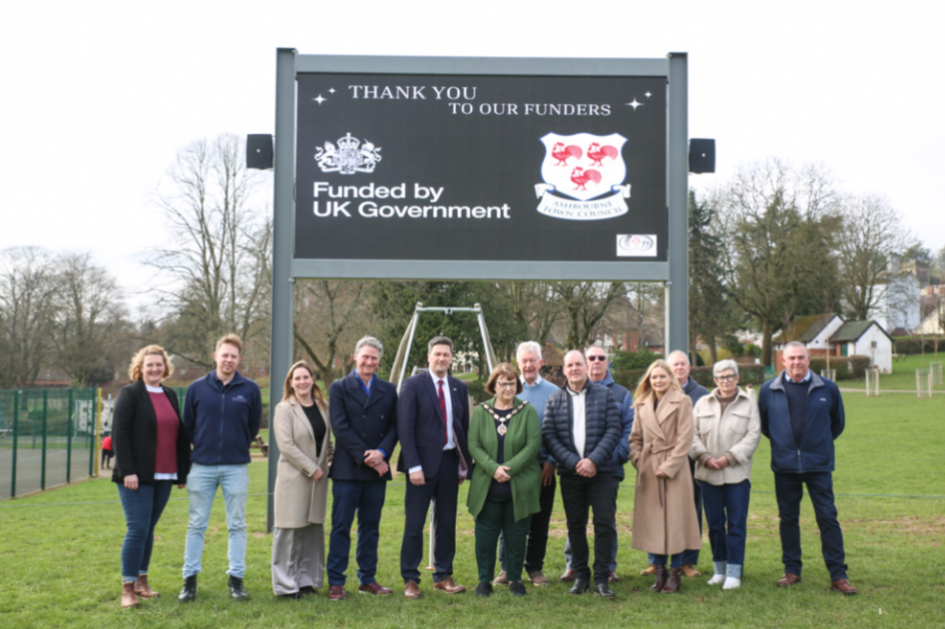
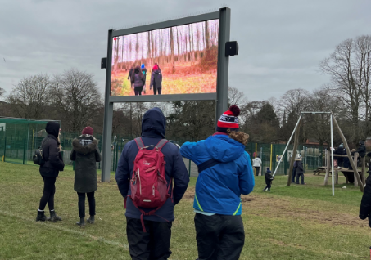
Ashbourne RGS & Community Partnership Capital Funding of £20,000
Scoreboard and Screen
Notes:
Recommended display time: 14 seconds.

Slide 3
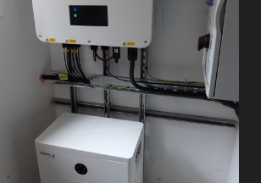
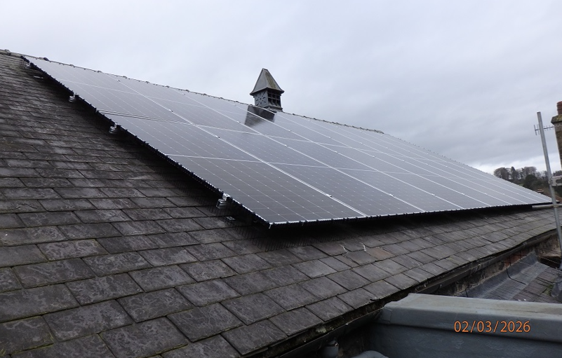
Bakewell Town and Community Trust
Capital Funding of £10,500
Solar Panels and Batteries
Notes:
Recommended display time: 18 seconds.

Slide 4
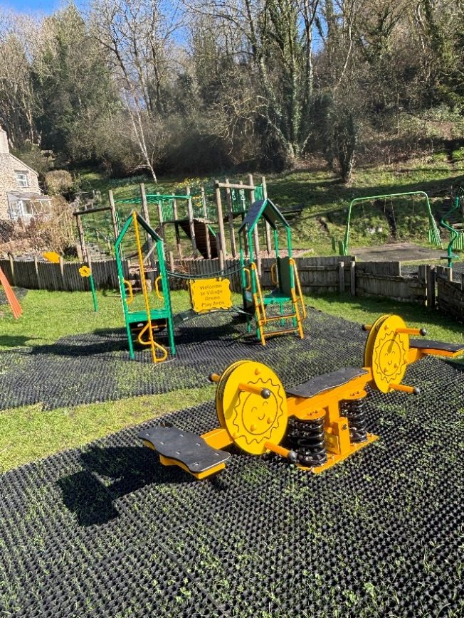
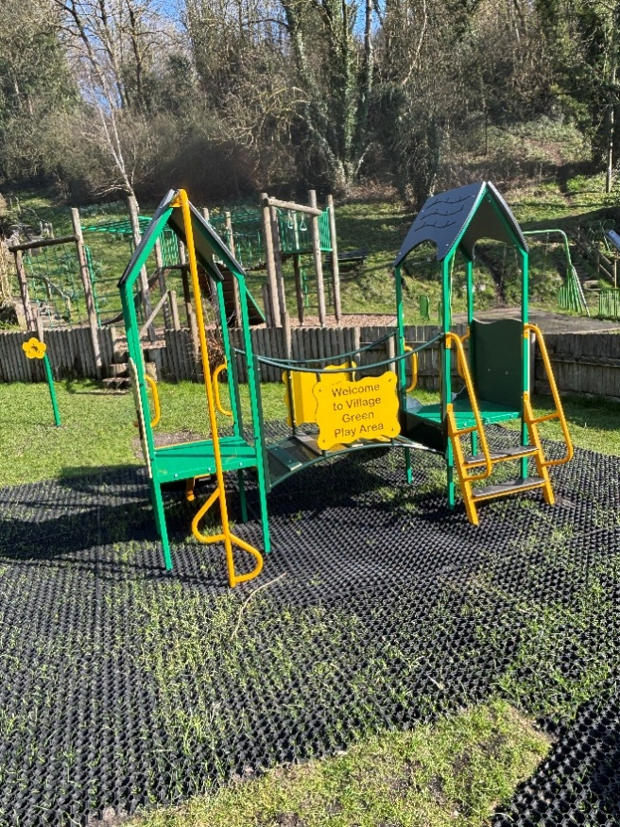
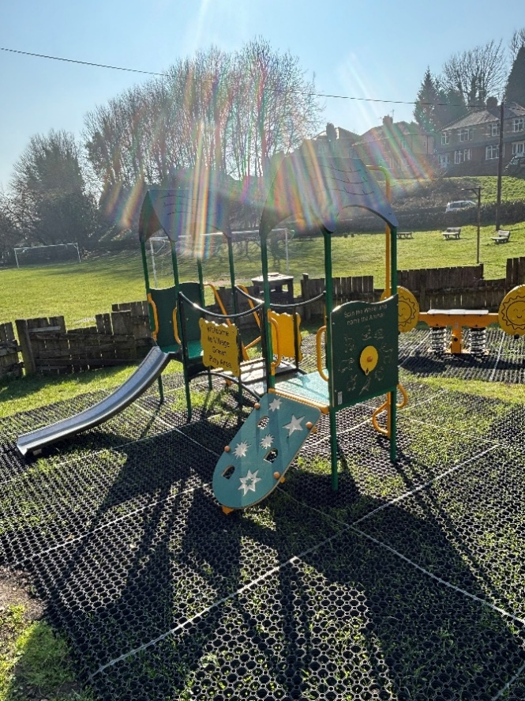
Bonsall Parish Council
Capital Funding of £16,000
New play equipment for children’s playground.
Notes:
Recommended display time: 15 seconds.

Slide 5
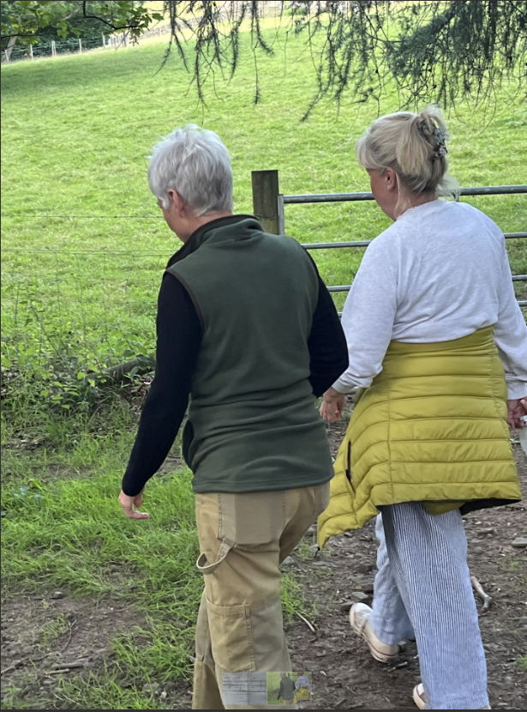
Farming Life Centre
Revenue Funding of £6,796.38*
Befriending project
Notes:
Recommended display time: 14 seconds.

Slide 6
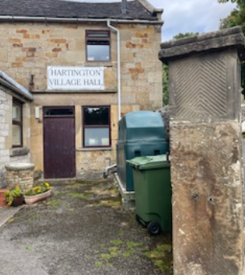
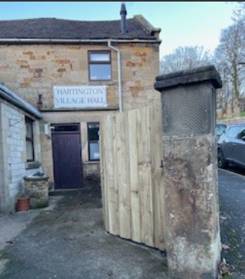
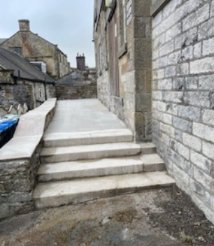
Hartington Village Hall
Capital Funding of £10,296
Courtyard & terrace improvements
Notes:
Recommended display time: 18 seconds.

Slide 7
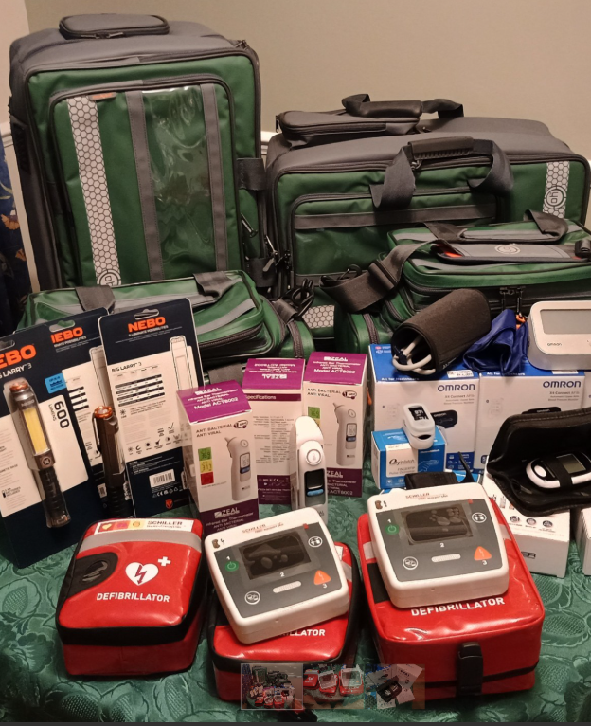
Matlock & District Community First Responders
Capital Funding of £8,490.99*
Specialist equipment and training
Notes:
Recommended display time: 18 seconds.

Slide 8
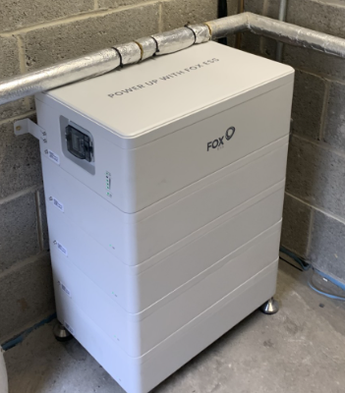
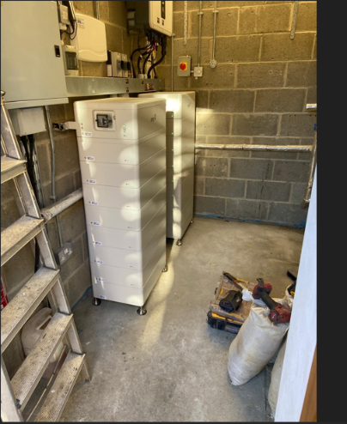
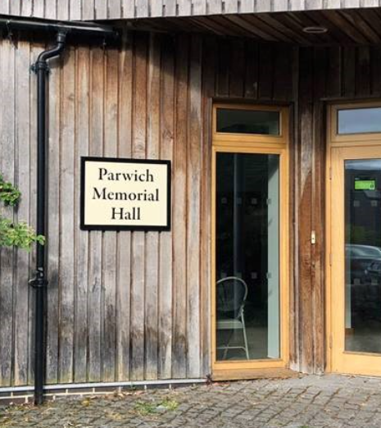
Parwich Memorial Hall
Capital Funding of £17,200
Batteries for storing solar power generated electricity
Notes:
Recommended display time: 15 seconds.

Slide 9

River Network
Revenue Funding of £1,440
Volunteer training & recruitment
Notes:
Recommended display time: 20 seconds.

Slide 10
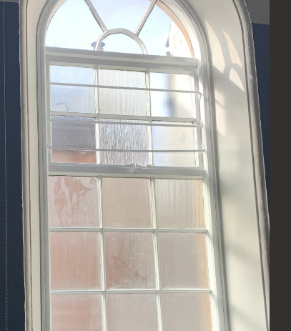
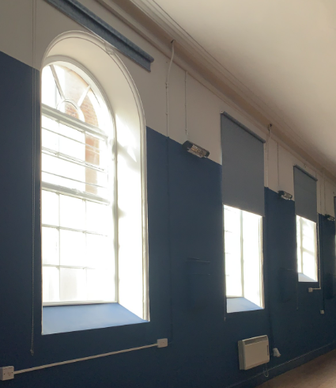
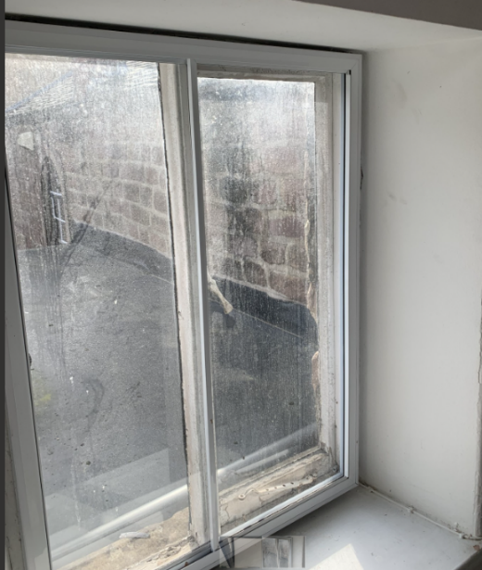
The Maltings
Capital Funding of £22,996
Secondary glazing / insulation
Notes:
Recommended display time: 15 seconds.

Slide 11
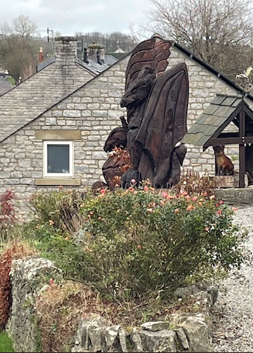
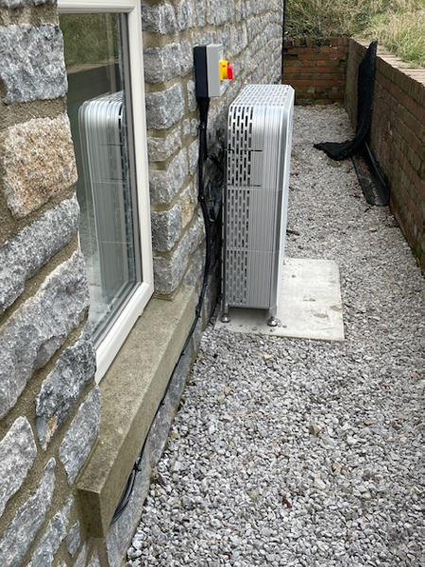
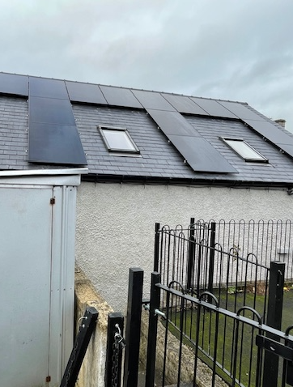
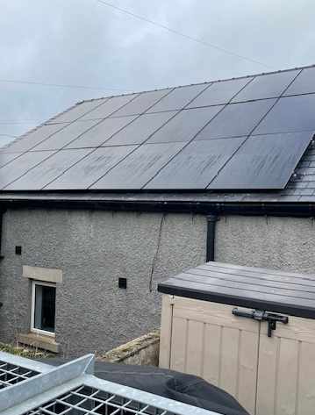
Tideswell Community Hall
Capital Funding of £12,000
Solar panels, inverter and battery storage
Notes:
Recommended display time: 18 seconds.

Slide 12
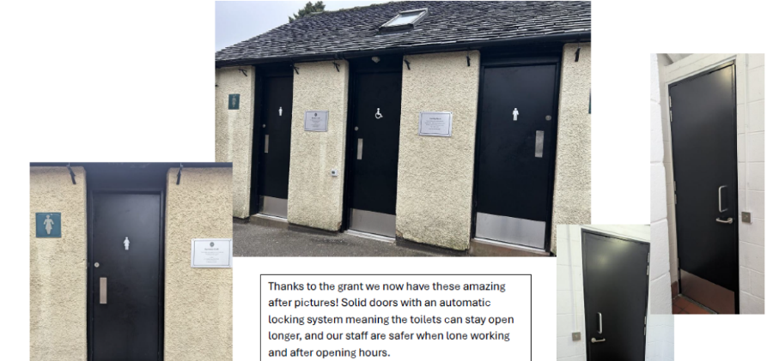
Wirksworth Town Council
Capital Funding of £9,001.60
Improvements to public toilets
Notes:
Recommended display time: 14 seconds.

Slide 13
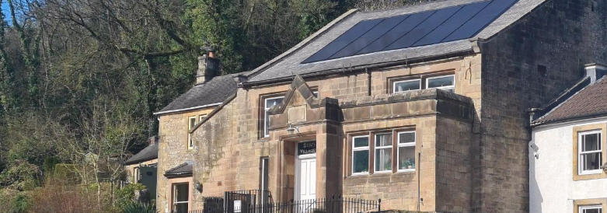
Bonsall Village Hall
Capital Funding of £8,624
Solar Panels and Battery Storage
Notes:
Recommended display time: 18 seconds.

Slide 14
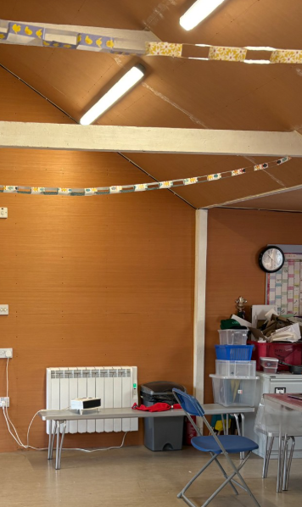
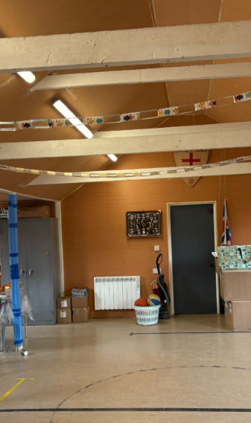
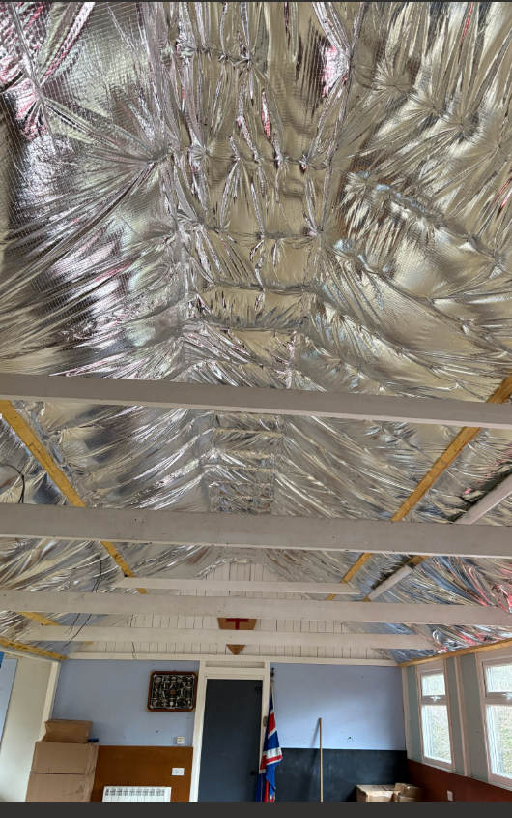
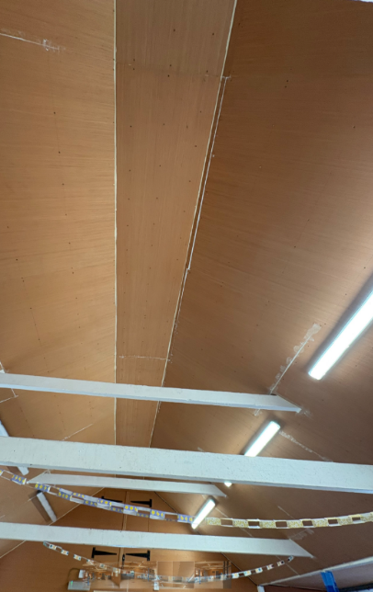
Darley Dale Scouts Group
Capital Funding of £8,000
Insulation of Scout Hall
Notes:
Recommended display time: 14 seconds.

Slide 15
Hurst Farm Regeneration Ltd Capital Funding of £6,813
Electric/water connection, candle making and bee keeping equipment
Notes:
Recommended display time: 20 seconds.

Slide 16
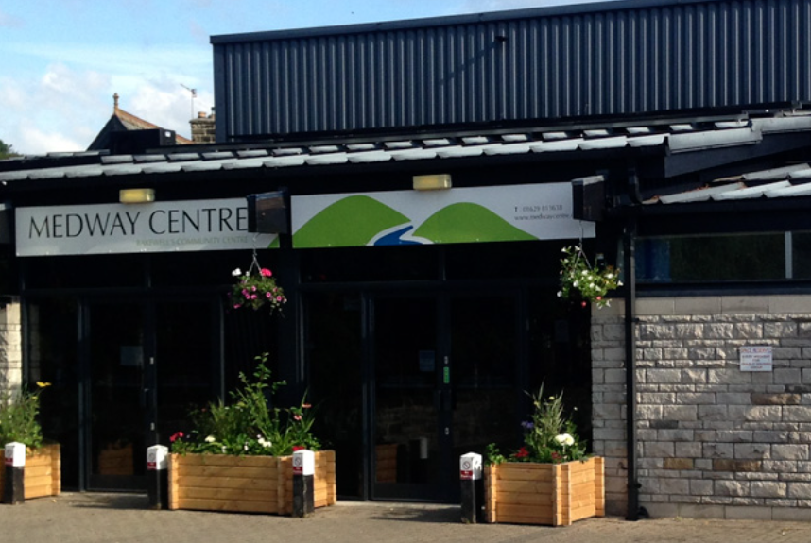
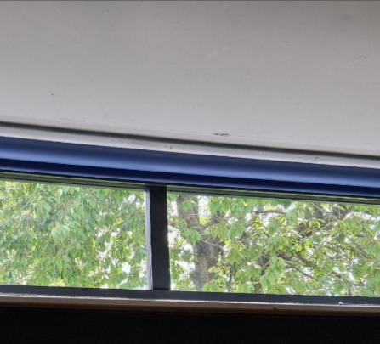
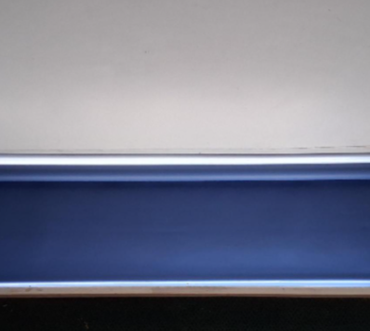
Medway Community Centre
Capital Funding of £6,574
Medway Energy Efficiency Project
Notes:
Recommended display time: 15 seconds.

Slide 17
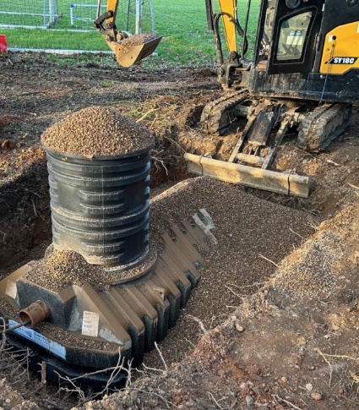
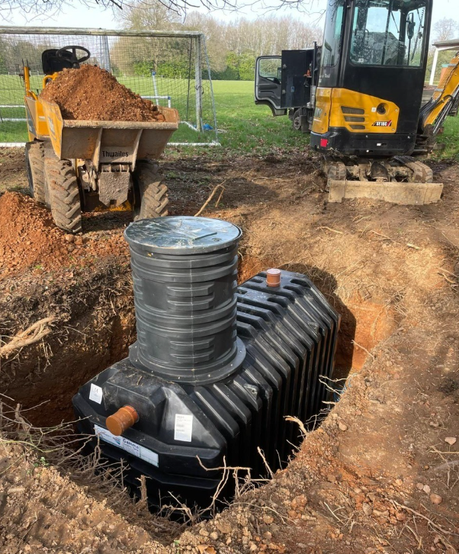
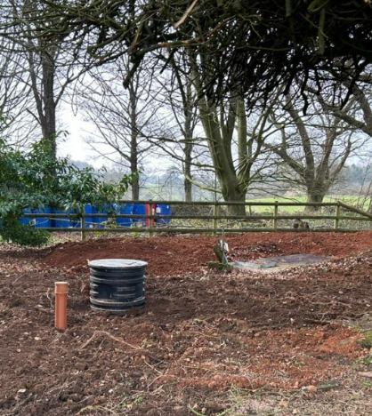
Osmaston Polo Ground
Capital Funding of £7,168
Sewerage / drainage works
Notes:
Recommended display time: 14 seconds.

Slide 18
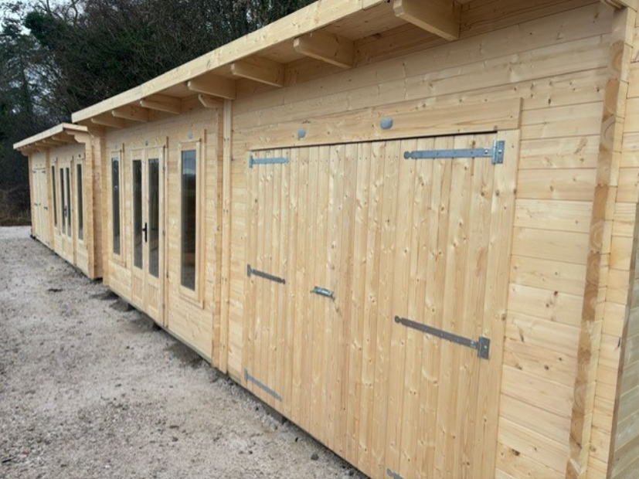
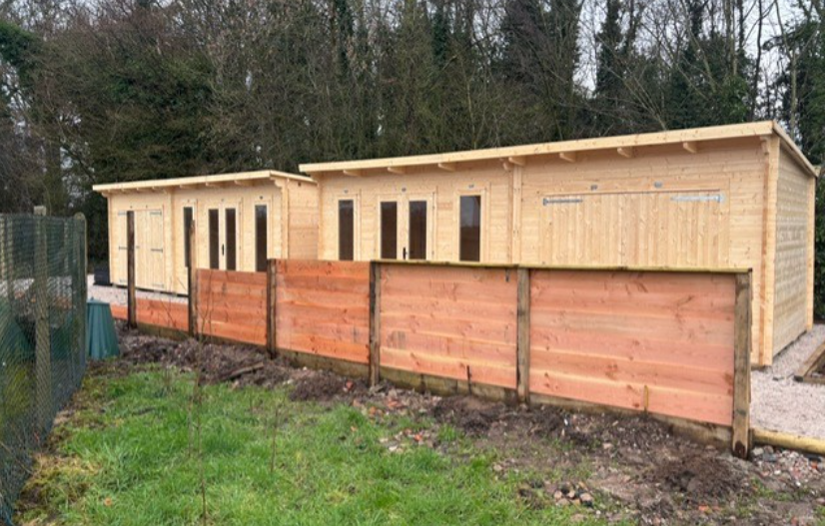
Sudbury Gasworks Regeneration Trust Capital Funding of £11,550
Partial award for outbuildings.
Notes:
Recommended display time: 14 seconds.

